Slide 1


Building Resilient Applications with Polly
By: Shailen Sukul

Slide 2
What is Polly and why do I need it?
Polly is a resilience framework for .NET available as a .NET Standard Library so it can run on your web services, desktop apps, mobile apps and inside your containers—anywhere .NET can run.
As the name suggests, the Retry policy lets you retry a failed request due to an exception or an unexpected or bad result returned from the called code.

Slide 3
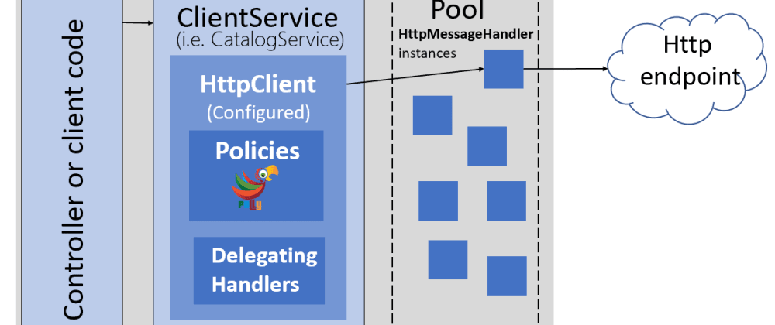
Example

Slide 4
Types of Polly Policies
Retry - Allows configuring automatic retries.
Circuit-breaker - Breaks the circuit (blocks executions) for a period, when faults exceed some pre-configured threshold.
Timeout - Guarantees the caller won't have to wait beyond the timeout.
Bulkhead Isolation - Constrains the governed actions to a fixed-size resource pool, isolating their potential to affect others.
Rate-limit - Constrains executions to not exceed a certain rate.

Slide 5
Types of Polly Policies
Cache - Provides a response from cache if known. Stores responses automatically in cache, when first retrieved.
Fallback - Defines an alternative value to be returned (or action to be executed) on failure.
PolicyWrap - Allows any of the above policies to be combined flexibly. See more at: https://github.com/App-vNext/Polly

Slide 6
Demo
The demo has 2 projects:
Unrealiable-Service – has 2 endpoints which return a list of projects
/Product/v1/GetProducts - reliable
/Product/v2/GetProducts – unreliable
Client – an MVC project which calls the unreliable service with 2 buttons
Button 1 – call and hope for the best
Button 2 – call using a typed HttpClient with a retry policy
Download the demo from : https://github.com/shailensukul/polly-research

